Slide 1

Segmenting e-Commerce Customer through Data Mining Techniques​
Yazeed Mwafi - 202020186
Laith Jaber - 202010517

Slide 2

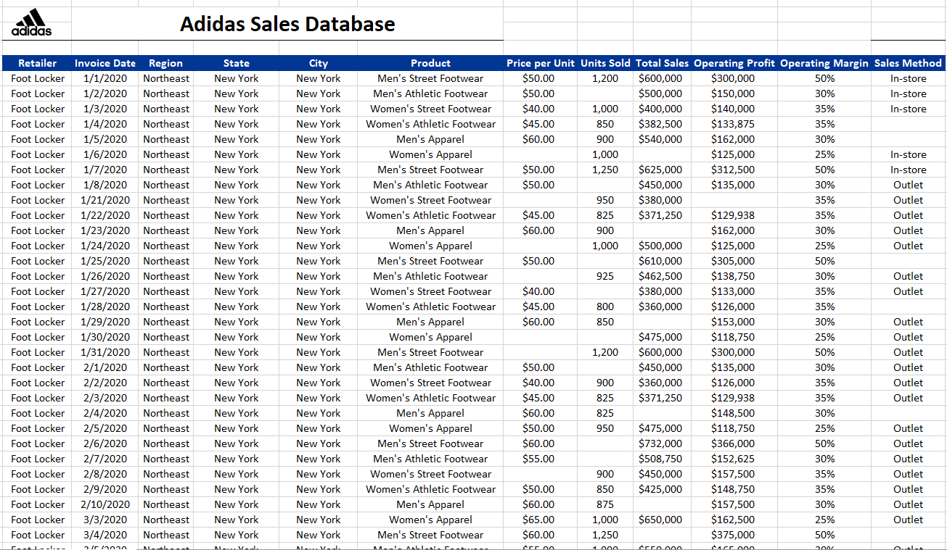
Data collection
First, for this analysis we took this database that displays products sold through the adidas stores in USA.
Then, we load it to Weka.
Dataset link : Kaggle-Adidas sales database

Slide 3

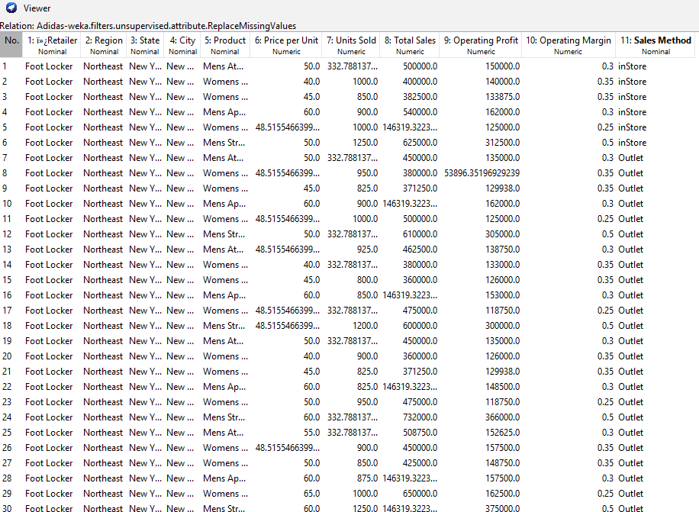
Data preprocessing
We have a lot of nulls so we'll start by handling the missing values.
To handle missing values , we applied “ReplaceMissingValues” filter that replace missing values with mean/mode.

Slide 4
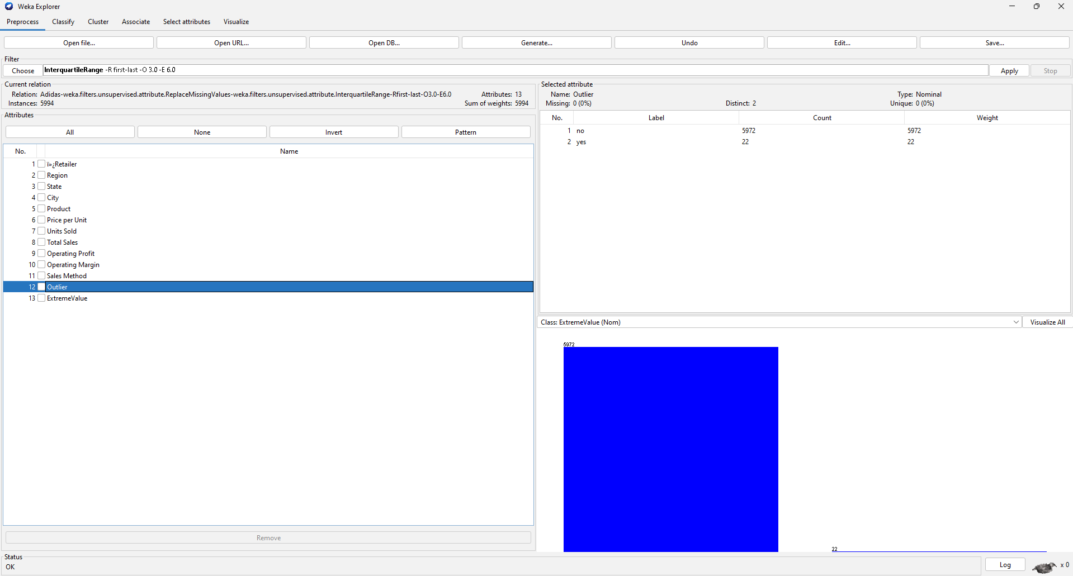
Data preprocessing (Cont.)
We applied “InterquartileRange” (IQR) filter to detect the outliers.

Slide 5

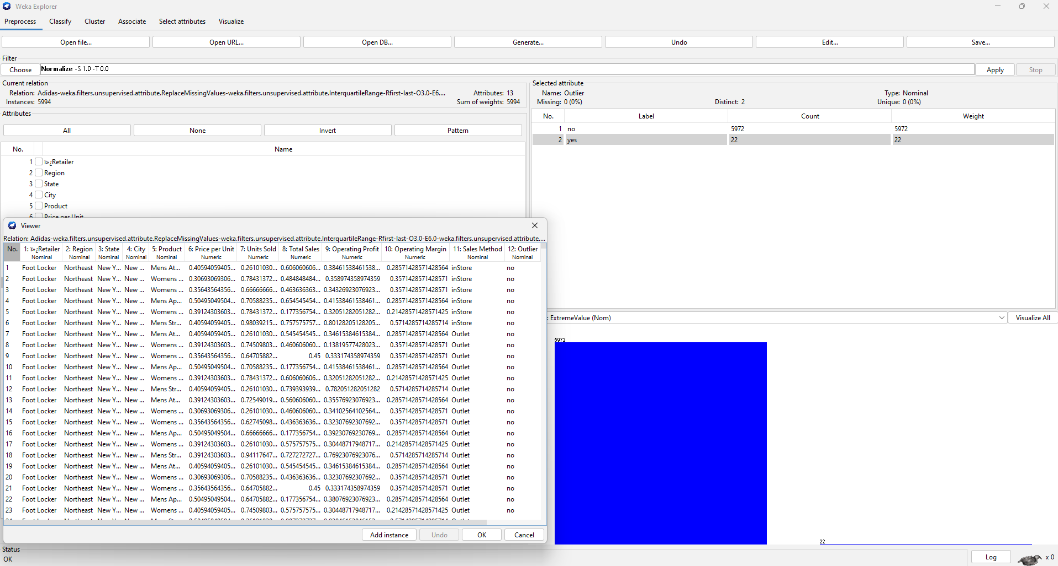

We applied the “Normalize” filter to handle the outliers
When we applied the “Normalize” filter, we observed no changes in the outliers.
So, we decided to drop the outliers by applying “RemoveWithValues” filter.

Slide 6
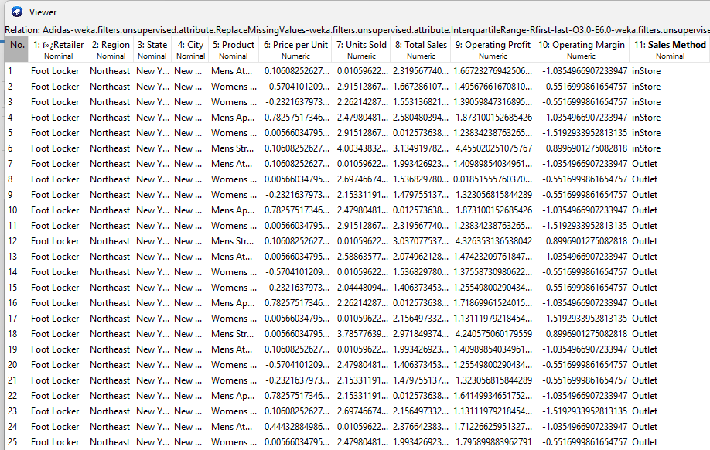
Data preprocessing (Cont.)
Then, we applied “Standardize” filter to standardize numeric attributes,

Slide 7
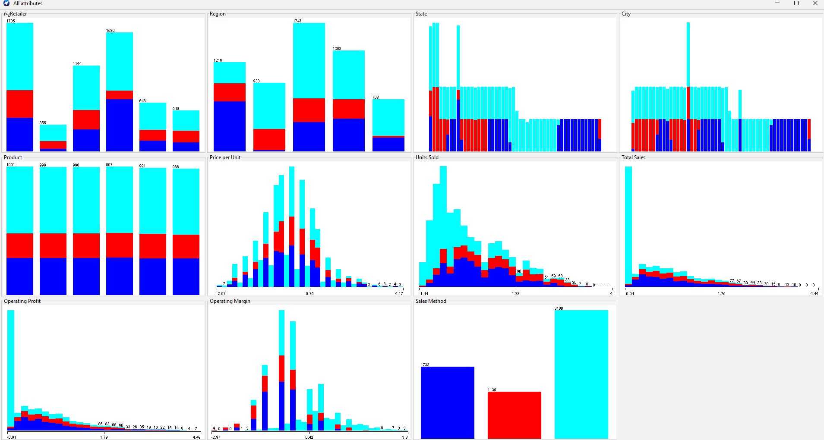
Visualizing all attributes

Slide 8
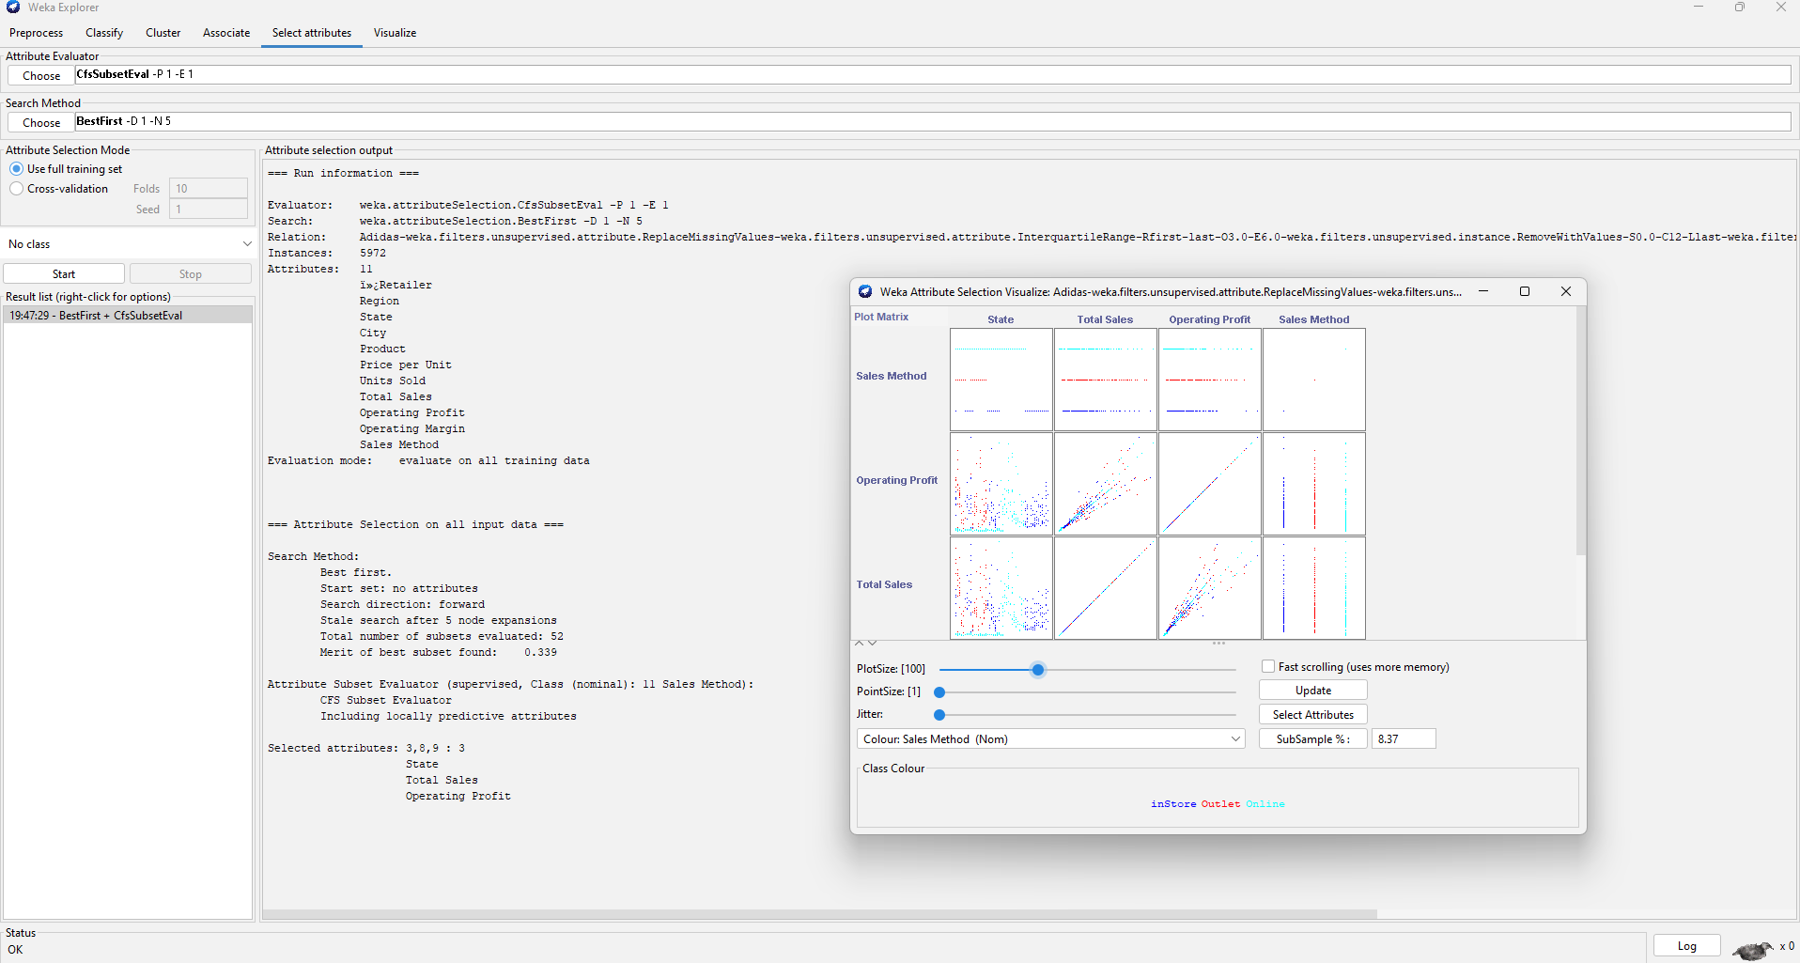
Features Selection
After all the steps shown above, we selected some attributes using “CfsSubsetEval” attributed evaluator.
According to the algorithm we chose above, we picked up the “BestFirst” selecting method to nominate the most useful attributes.

Slide 9
Clustering
In our clustering analysis, we employed three distinct algorithms: K-means, EM (Expectation-Maximization), and hierarchical clustering.
Following a thorough evaluation of their respective performances, we concluded that the K-means algorithm outperformed the others, making it our algorithm of choice for clustering in this particular context.

Slide 10
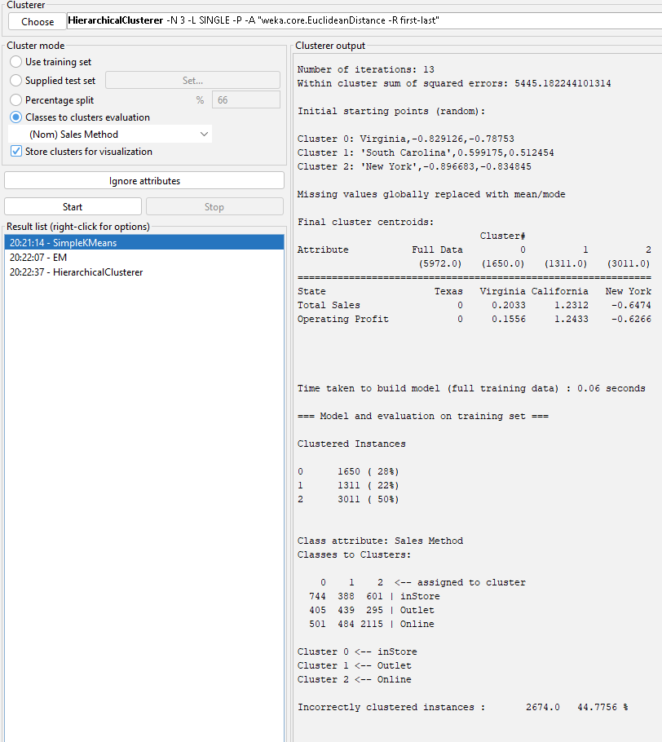
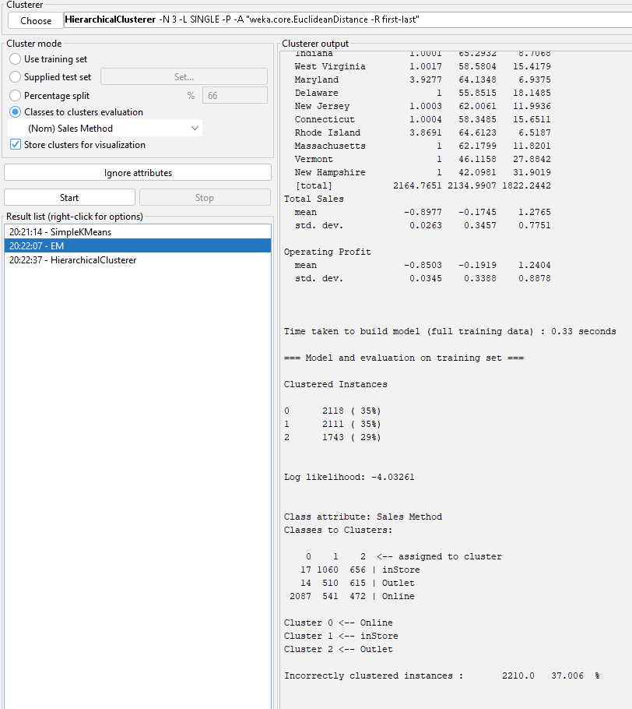
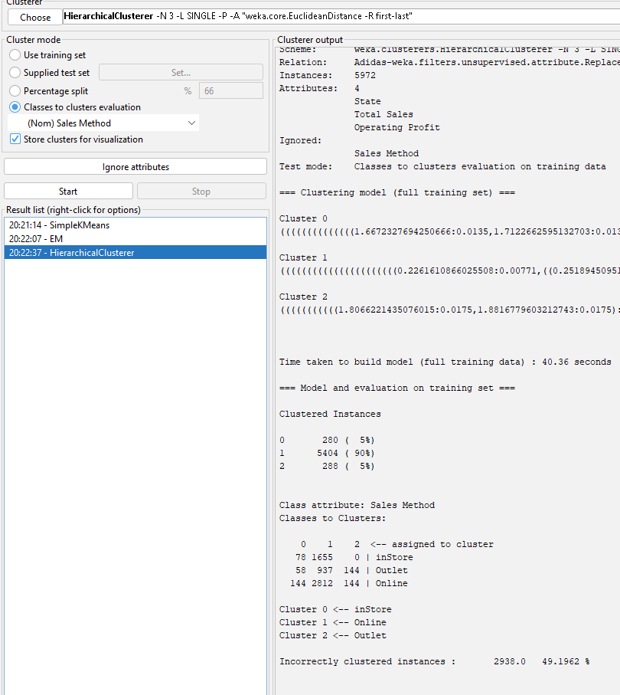
Clustering (Cont.)

Slide 11
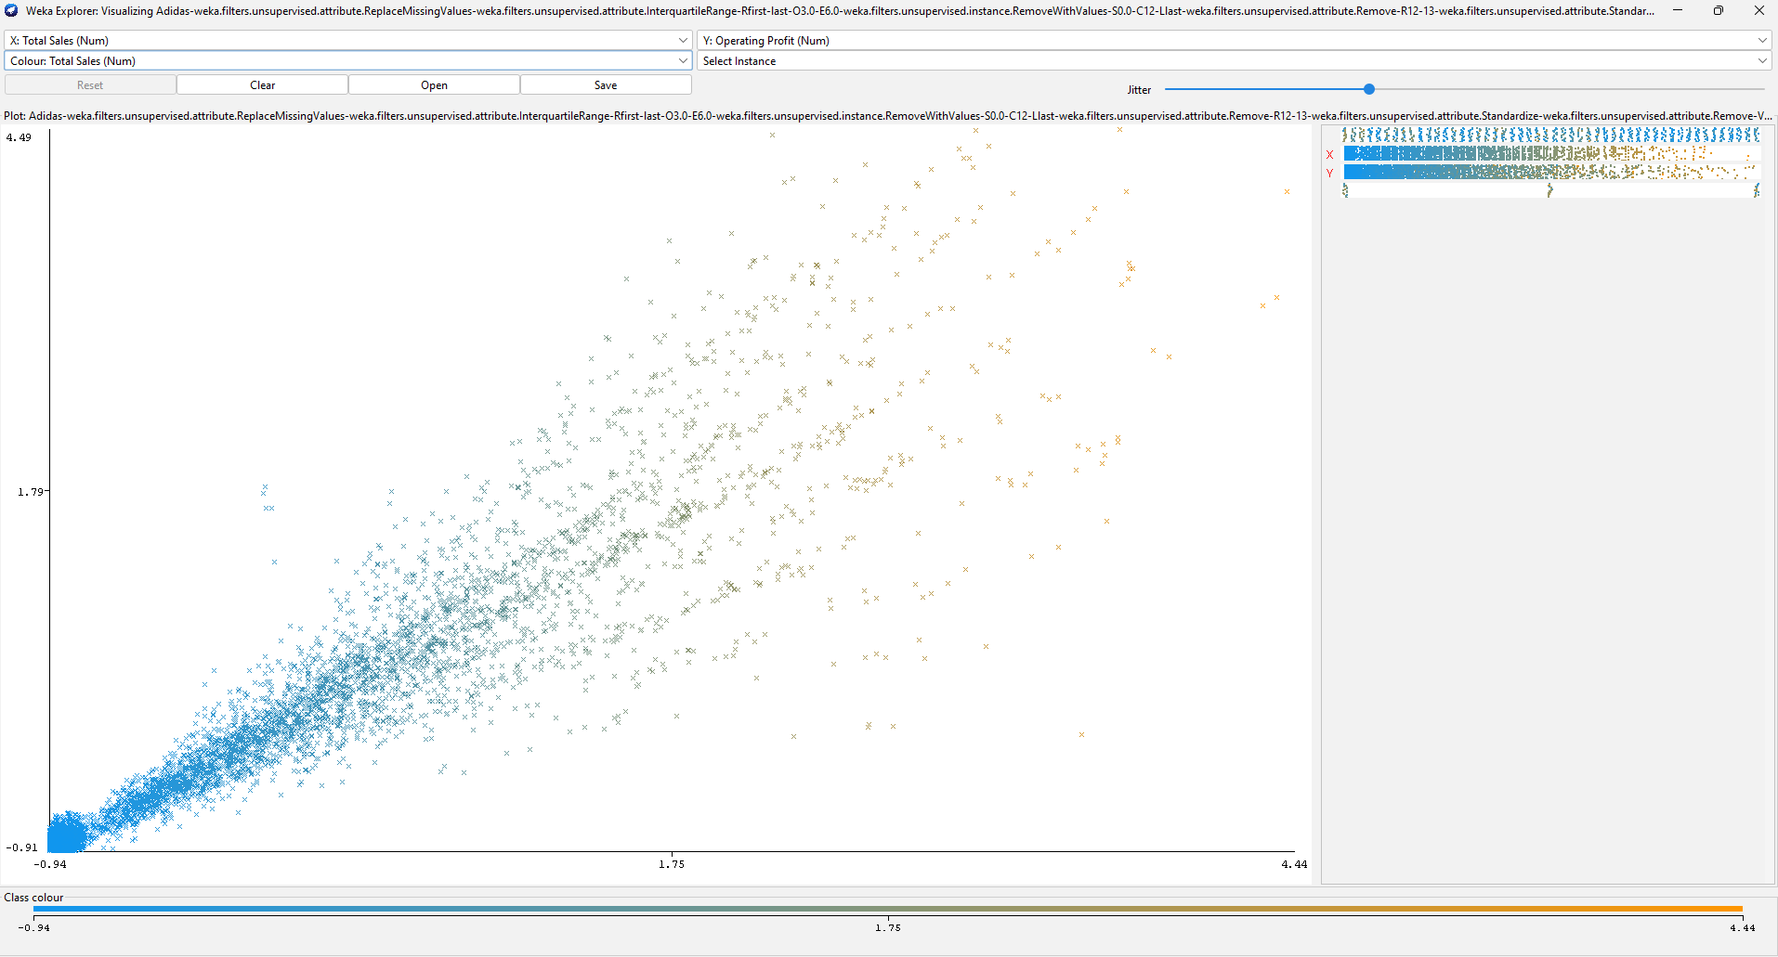
Visualization
As we noticed, when total sales increase, profit also increases.

Slide 12
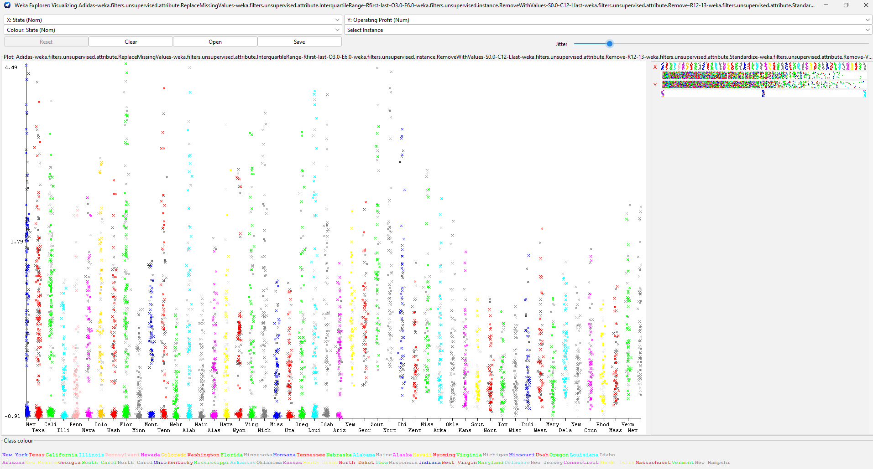
Visualization(Cont.)
New York, Florida, Texas, and Alabama are states where the highest profit was observed.

Slide 13
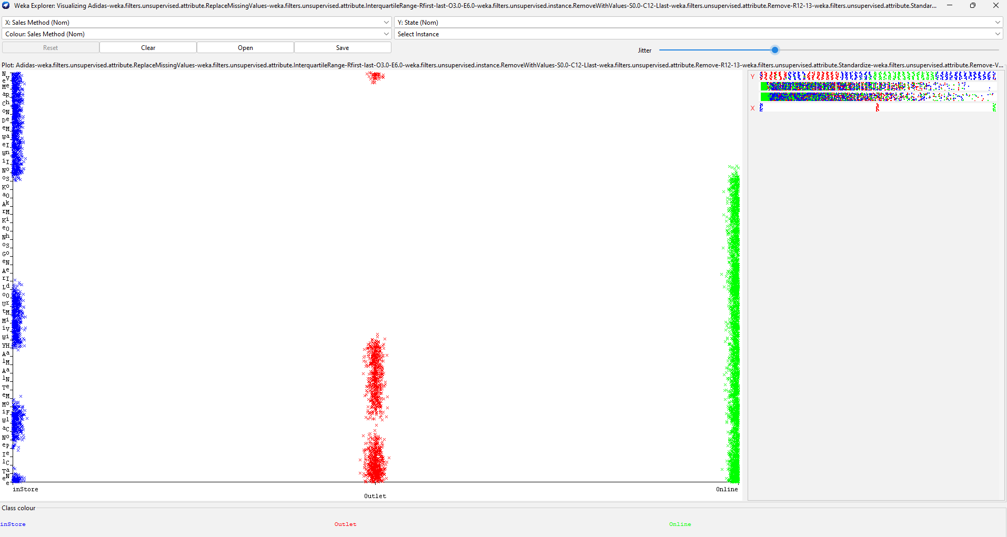
Visualization(Cont.)
As we can see, people prefer to buy items from online stores and instore.

